Slide 1
Lecture 6:
Neural Networks part 2

Slide 2
Optional help session this Friday
Vector, Matrix, and Tensor Derivatives + the Chain Rule
9am CS building

Slide 3
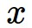
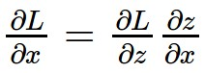
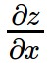
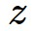
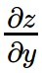
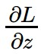
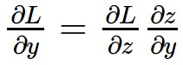
activations
f
“local gradient”
gradients

Slide 4
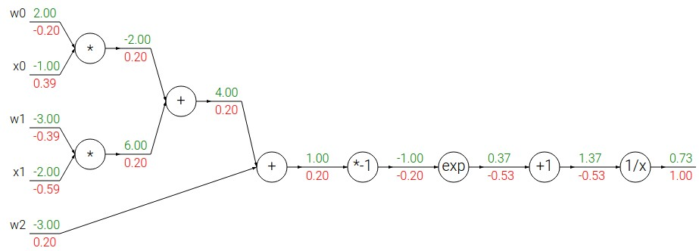
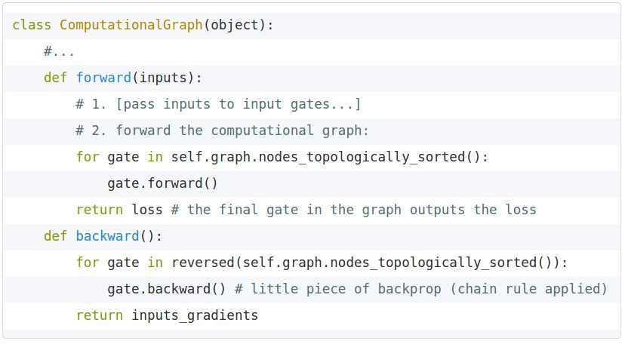
Implementation: forward/backward API
Graph (or Net) object. (Rough pseudo code)

Slide 5
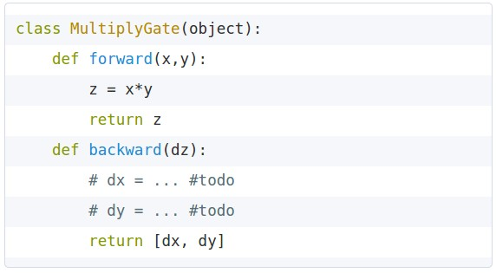
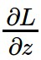
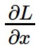
Implementation: forward/backward API
x
z
*
y
(x,y,z are scalars)

Slide 6
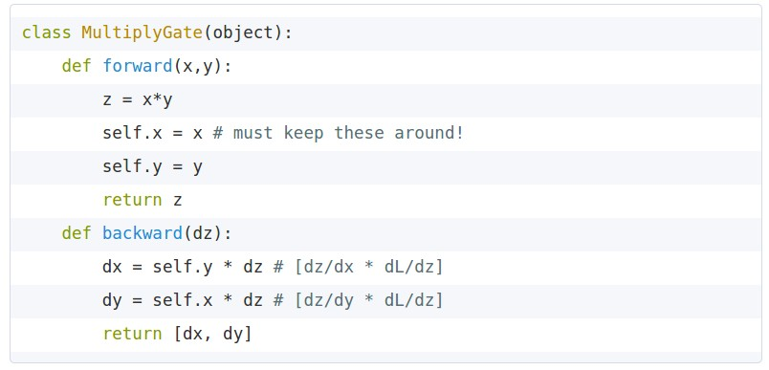

Implementation: forward/backward API
x
z
*
y
(x,y,z are scalars)

Slide 7
Vectorized operations
f(x) = max(0,x)
(elementwise)
4096-d
input vector
4096-d
output vector

Slide 8
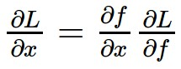
Vectorized operations
Jacobian matrix
f(x) = max(0,x)
(elementwise)
4096-d
input vector
4096-d
output vector
Q: what is the size of the Jacobian matrix?

Slide 9
Gradients for vectorized code
(x,y,z are now vectors)
This is now the Jacobian matrix (derivative of each element of z w.r.t. each element of x)
f
“local gradient”
gradients

Slide 10
Vectorized operations
Jacobian matrix
max(0,x)
(elementwise)
f(x) = max(0,x)
(elementwise)
4096-d
input vector
4096-d
output vector
Q: what is the size of the Jacobian matrix?
[4096 x 4096!]
Q2: what does it look like?

Slide 11
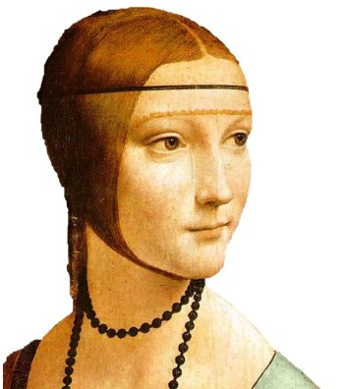
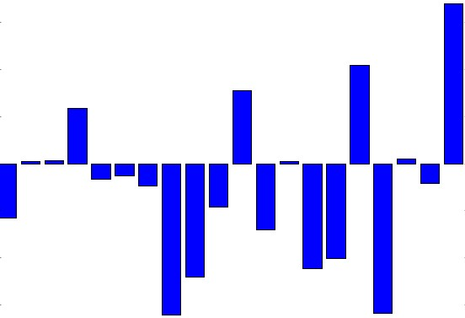
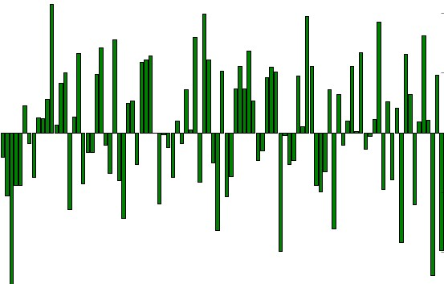
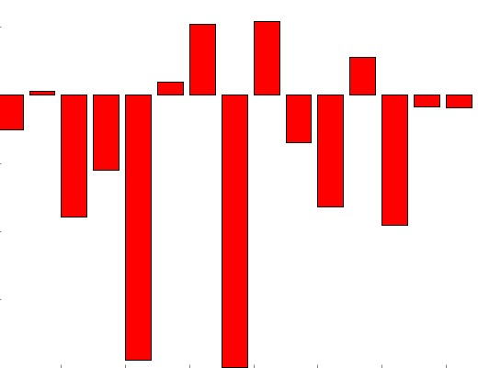
Aside: Image Features

Slide 12

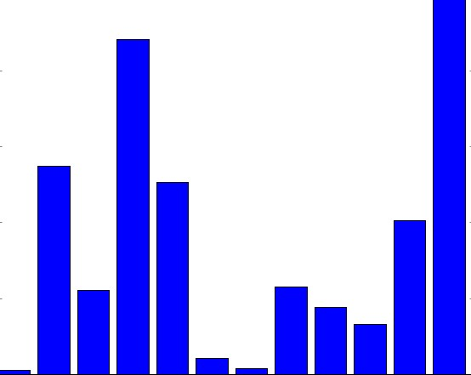
Example: Color (Hue) Histogram
hue bins
+1

Slide 13
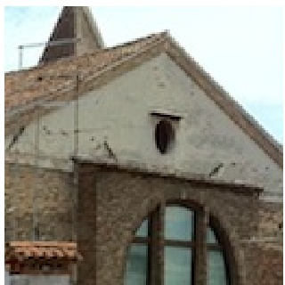
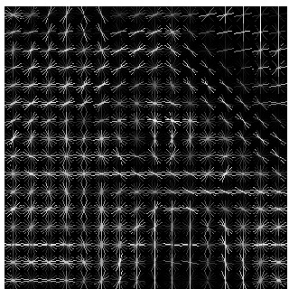
Example: HOG/SIFT features
8x8 pixel region,
quantize the edge orientation into 9 bins
(image from vlfeat.org)

Slide 14
Example: HOG/SIFT features
8x8 pixel region,
quantize the edge orientation into 9 bins
Many more:
GIST, LBP, Texton, SSIM, ...
(image from vlfeat.org)

Slide 15
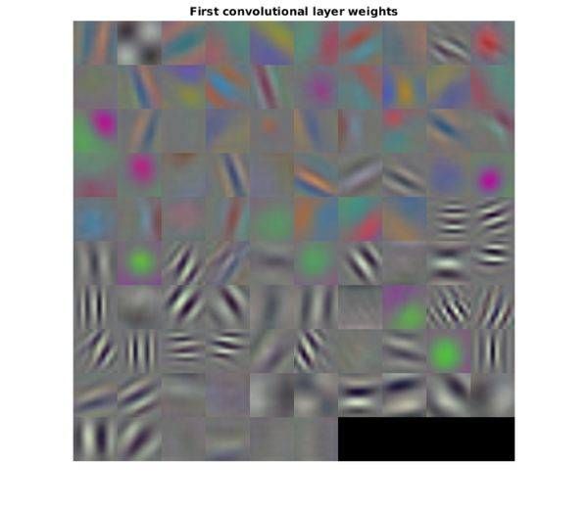
Jointly learning about edges and colors

Slide 16
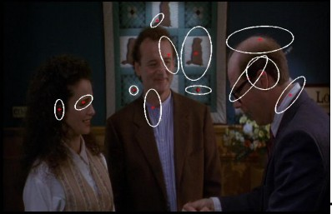
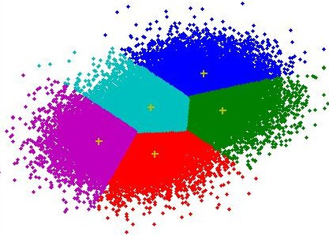

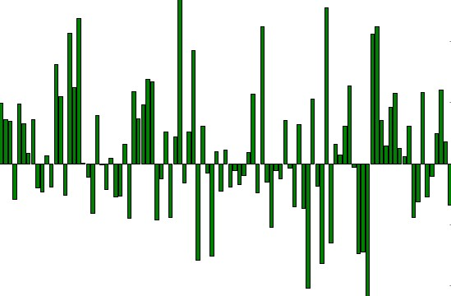

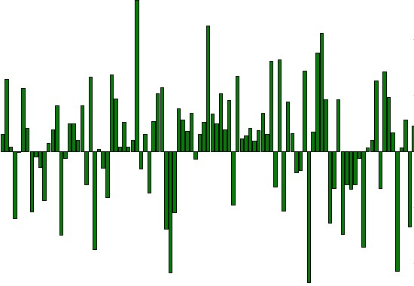
Example: Bag of Words
histogram of visual words
visual word vectors
learn k-means centroids
“vocabulary” of visual words
1000-d vector
144
1000-d vector
1000-d vector
e.g. 1000 centroids

Slide 17


vector describing various image statistics
f
Feature Extraction
10 numbers, indicating class scores
training
[32x32x3]
f
10 numbers, indicating class scores
training
[32x32x3]

Slide 18
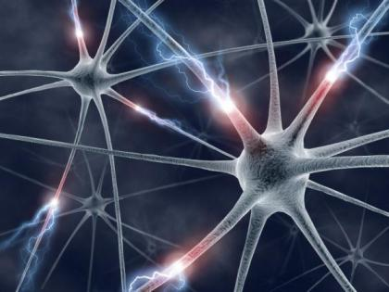

Slide 19
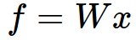
Neural Network:
(Before) Linear score function:

Slide 20
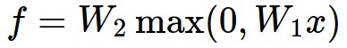
Neural Network:
(Before) Linear score function:
(Now) 2-layer Neural Network

Slide 21
Neural Network:
(Before) Linear score function:
(Now) 2-layer Neural Network
x
h
W1
W2
s
3072
100
10

Slide 22
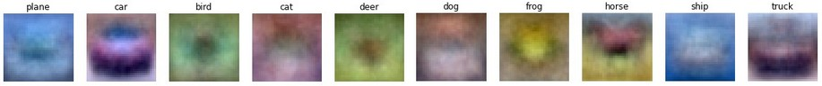
Neural Network:
(Before) Linear score function:
(Now) 2-layer Neural Network
x
h
W1
W2
s
3072
100
10

Slide 23
Neural Network:
(Before) Linear score function:
(Now) 2-layer Neural Network
or 3-layer Neural Network

Slide 24
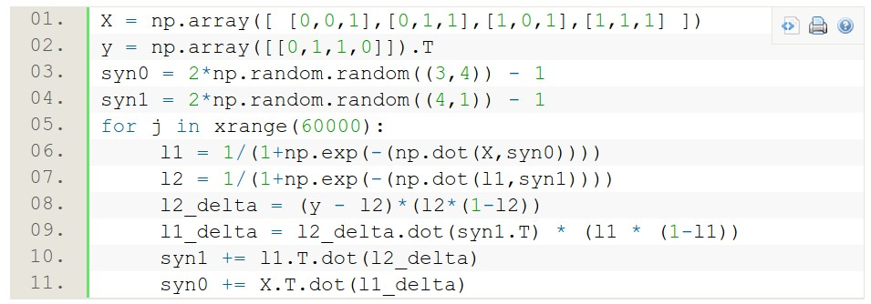
Full implementation of training a 2-layer Neural Network needs ~11 lines:
from @iamtrask, http://iamtrask.github.io/2015/07/12/basic-python-network/

Slide 25
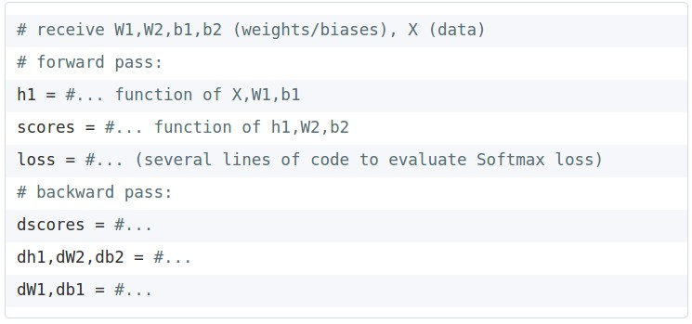
Assignment: Writing 2layer Net
Stage your forward/backward computation!

Slide 27


Slide 28


Slide 29
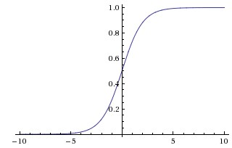
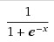
sigmoid activation function

Slide 30
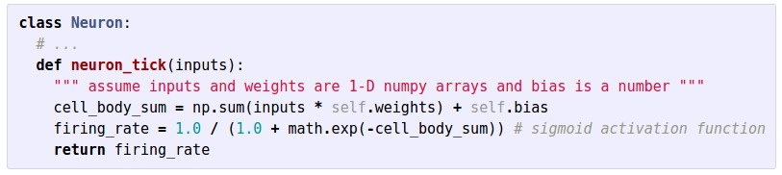

Slide 31
Hubel and Wiesel demo.

Slide 32
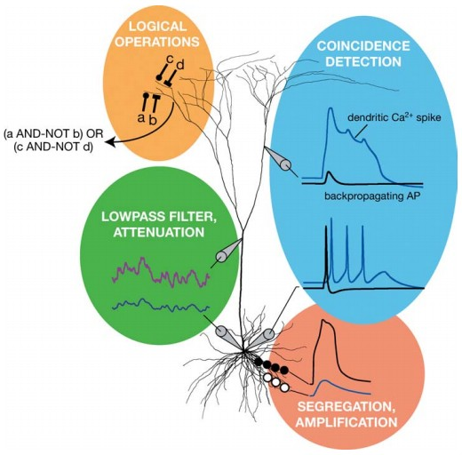
Be very careful with your Brain analogies:
Biological Neurons:
Many different types
Dendrites can perform complex non-linear computations
Synapses are not a single weight but a complex non-linear dynamical system
[Dendritic Computation. London and Hausser]

Slide 33
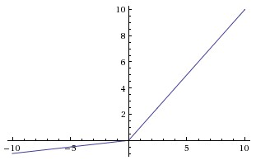

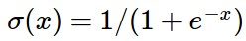
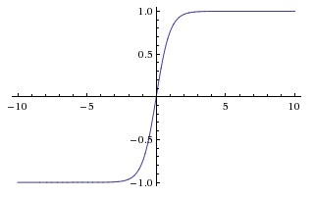
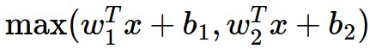
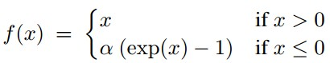
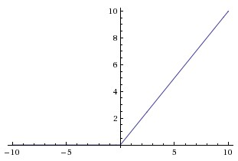
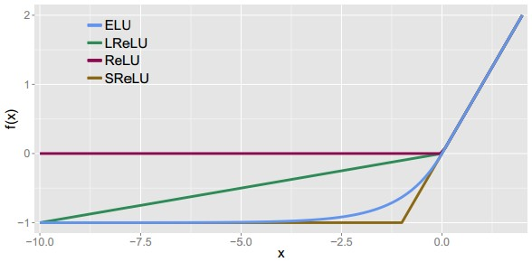
Activation Functions
Leaky ReLU
max(0.1x, x)
Sigmoid
Maxout
tanh tanh(x)
ELU
ReLU max(0,x)

Slide 34


Neural Networks: Architectures
“3-layer Neural Net”, or
“2-hidden-layer Neural Net”
“2-layer Neural Net”, or
“1-hidden-layer Neural Net”
“Fully-connected” layers

Slide 35
Example Feed-forward computation of a Neural Network
We can efficiently evaluate an entire layer of neurons.

Slide 36
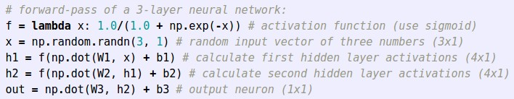
Example Feed-forward computation of a Neural Network

Slide 37

Setting the number of layers and their sizes
more neurons = more capacity

Slide 38
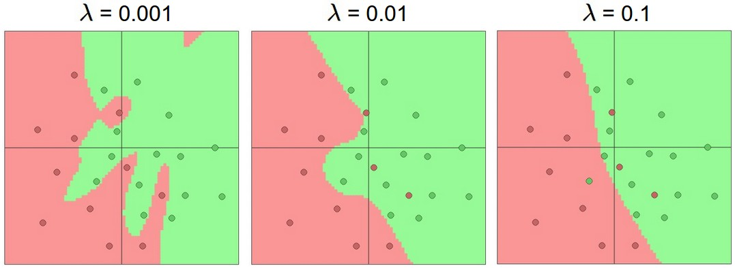
Do not use size of neural network as a regularizer. Use stronger regularization instead:
(you can play with this demo over at ConvNetJS: http://cs.stanford.edu/people/karpathy/convnetjs/demo/classify2d.html)

Slide 39
Summary
we arrange neurons into fully-connected layers
the abstraction of a layer has the nice property that it allows us to use efficient vectorized code (e.g. matrix multiplies)
neural networks are not really neural
neural networks: bigger = better (but might have to regularize more strongly)

Slide 40
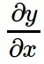
complex graph
inputs x
outputs y
reverse-mode differentiation (if you want effect of many things on one thing)
for many different x
forward-mode differentiation (if you want effect of one thing on many things)
for many different y

